Slide 1
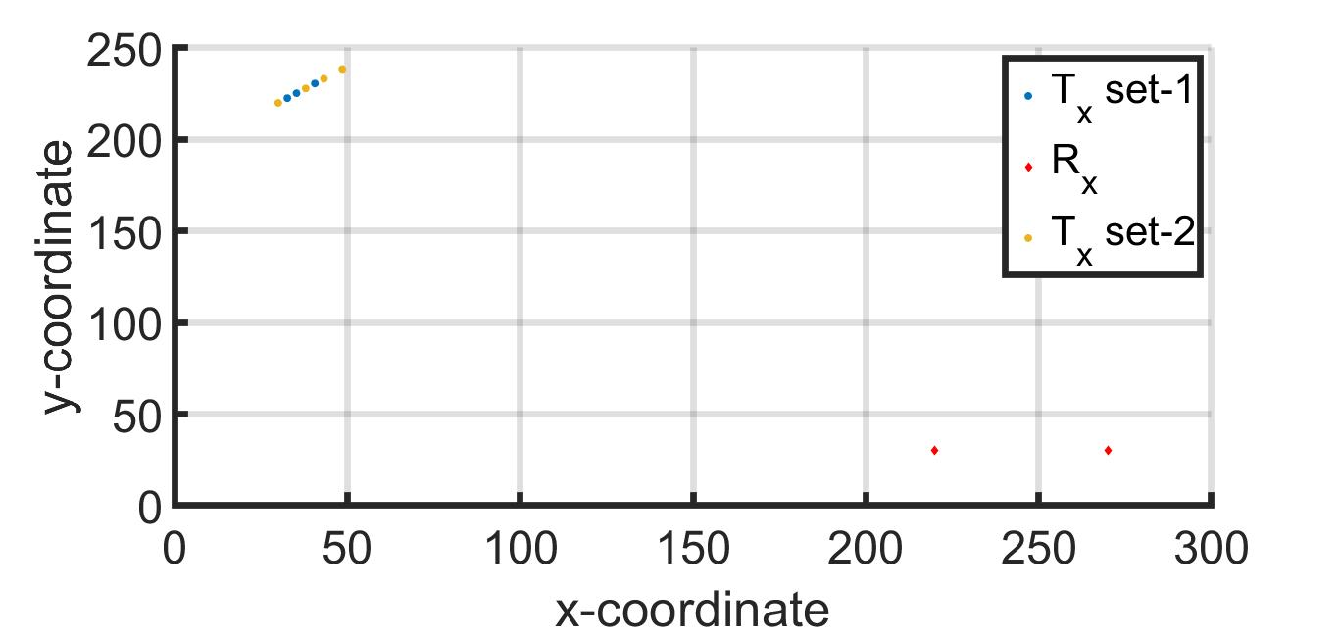
(x,y)-Position of Agents and Receivers

Slide 2
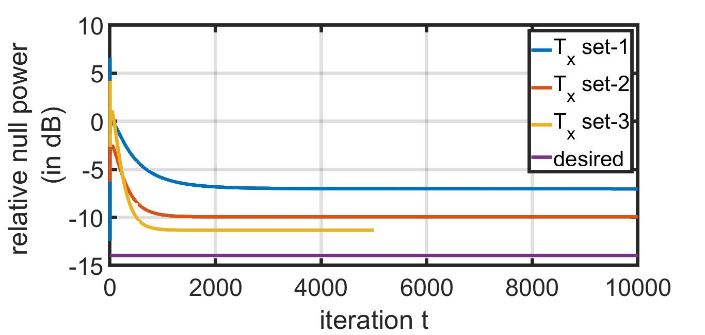
Result of IPG

